Slide 1

Scriptforce Milestone Project 2
Milestone Project Presentation Day
TECHCareers Cohort 4.2
September 2020
# Project Related Links
Assignment: https://drive.google.com/file/d/1TkQkSrqbAsLseSicMVCrTzICGsslFF_G/view?usp=sharing
Trello board: https://trello.com/b/QuSHXICc
GitHub Repo: https://github.com/TECHCareers-by-Manpower/milestone-2-react-redux-router-project-scriptorce
Figma Planning Documents: https://www.figma.com/file/LZIMp2h1294u6McLJMCeoy/Wireframing-in-Figma

Slide 2
Meet THE Scriptores
Team Spirit
COLLABORATION
COMMITMENT
RESPECT
“Coming together is a beginning.
Keeping together is progress.
Working together is success.”
Henry Ford
Ayesha Fatima | Kenji Au | Dharmeshkumar | Amr Fouad

Slide 3
Introduction
Non-profit website that features Donation and Shopping for a cause
The website has the typical non-profit websites Static components like:
The Unique Features In order to demonstrate the use of React, Redux and Router we have created Shop-for-Cause feature, in that we have
Products list, which is fed from fake-shop API
Show case the details of the product and its price
Add to shopping cart
Set of filters by category, price, etc.
Sort products by name, price, add date, etc.
Cart, for the user to manage the order (i.e., change qty., remove items)
Order confirmation, for the user to checkout the order and pay
Donation form, which simply run the user through sequence of forms to donate to the non-profit organization
Additional features were considered to show off our React, Redux and Router knowledge are:
Volunteer registration form
Regular user sign up form for newsletter
Regular user sing in form
Landing page | About, Mission and vision | Events and News | Contact us form | FAQ

Slide 4
Project Management – Work Flow
Setup
Work
Environment
Standard Work
Hurray ….! | Approval | Proposal | Voting | Brainstorming
!
Framework | Pseudo code | Work Distribution by Component | Coding | Testing
BIG Hurray ….! | Deliver | Refinement | Quality Control | Documentation

Slide 5









Project Management – Work Environment Setup
File management and version control
GitHub Repo
Initial folder structure setup
File names matching in Reducers, Action and Components
Trello Board
Google Drive
Figma
VS Live Share
Team Communications
Slack Workspace
WhatsApp
Zoom Meeting
NoteJoy

Slide 6
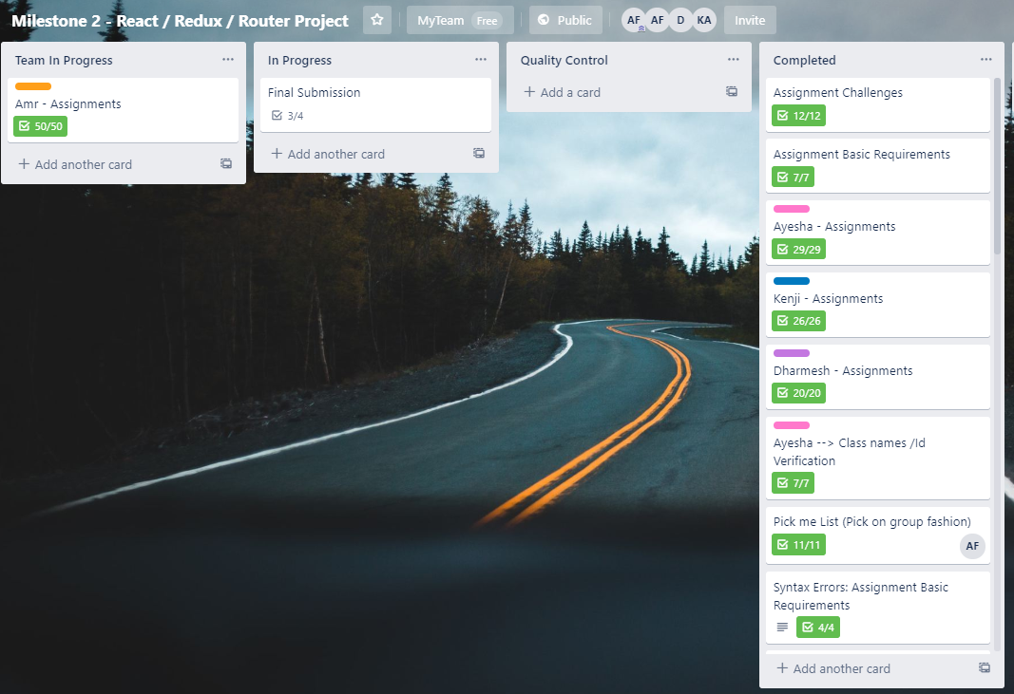
Project Management – Work Distribution

Slide 7
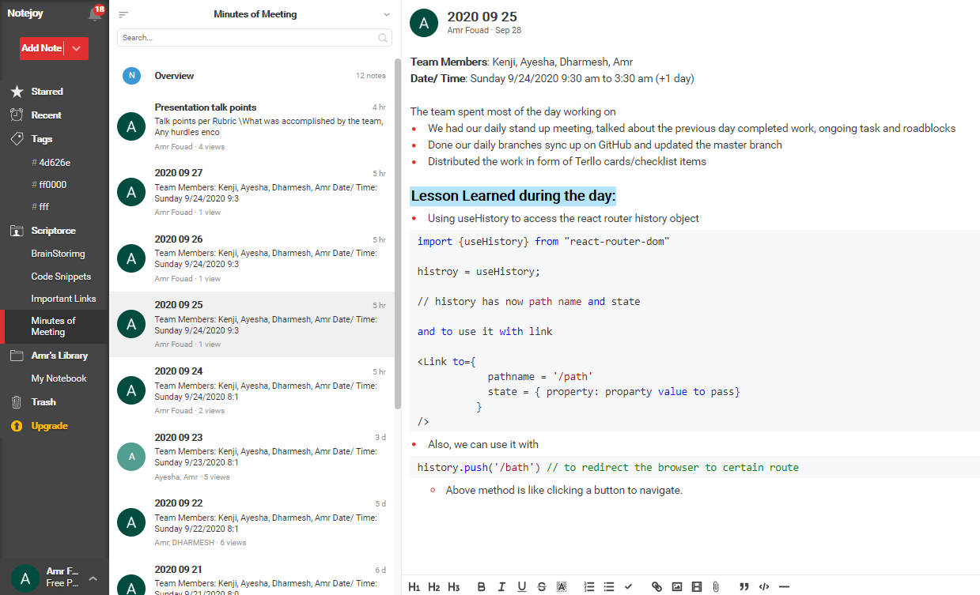
Project Management – Keep Track

Slide 8
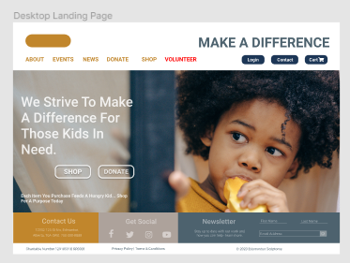
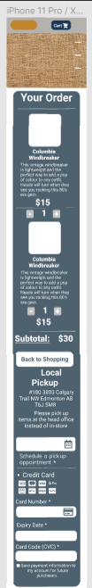
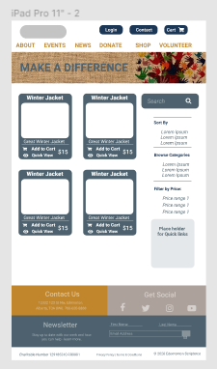
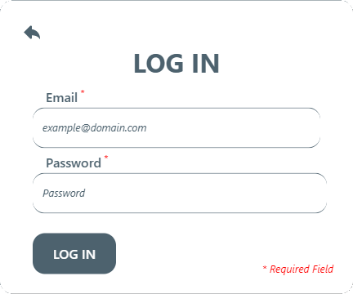
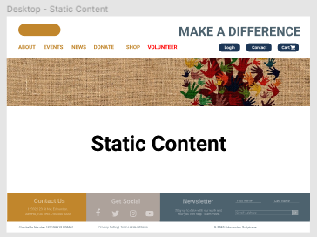
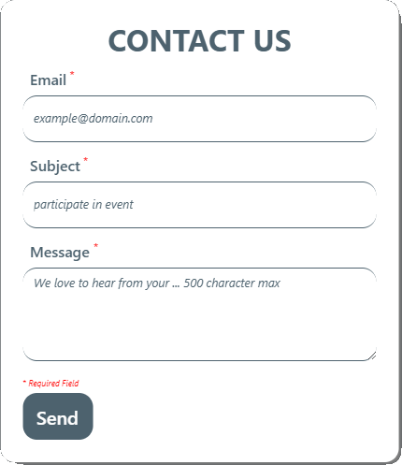
Project Management – Design … Wireframe …

Slide 9
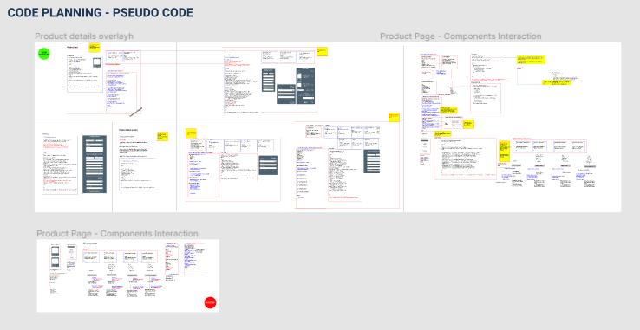
Project Management – Pseudo Coding

Slide 10
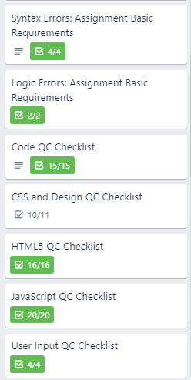
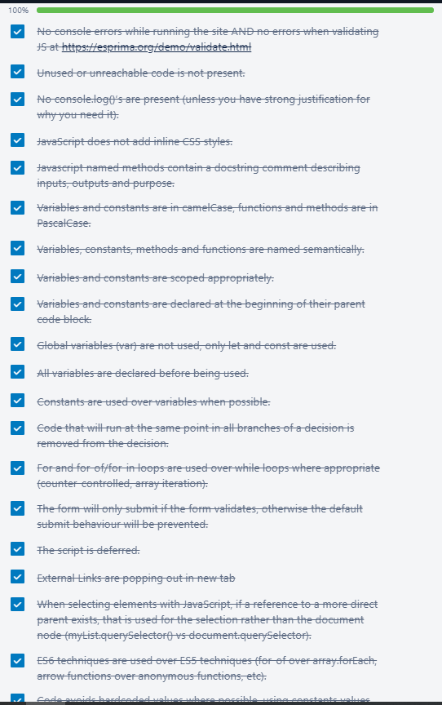
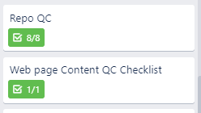
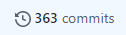
Project Management – Quality Control
Major Categories
Syntax errors
Logic errors
Code writing
CSS CARP
JSX/HTML
JS / REACT / REDUX
User Input
Repo
Content (e.g., spelling)

Slide 11
Project Management – Lesson Learned
Technical
Better understand of React and Redux
Using Libraries (React and Redux) – Date Picker and React Icons
Using React Hooks – useRef, useHistory and useLocation, etc.
RegEx
React components interaction and communication
Rendering outside index.js (e.g., product details overlay)
Git is crazy with file names
Project Management
Managing merge in Github
Central person pulling, resolving conflict
Using Figma
Leveraging team synergies, and learning from each other
All day co-programming environment
Morning stand up
Evening debrief
Keeping daily minutes of meeting to capture the lesson learnt and new practices sharing

Slide 12
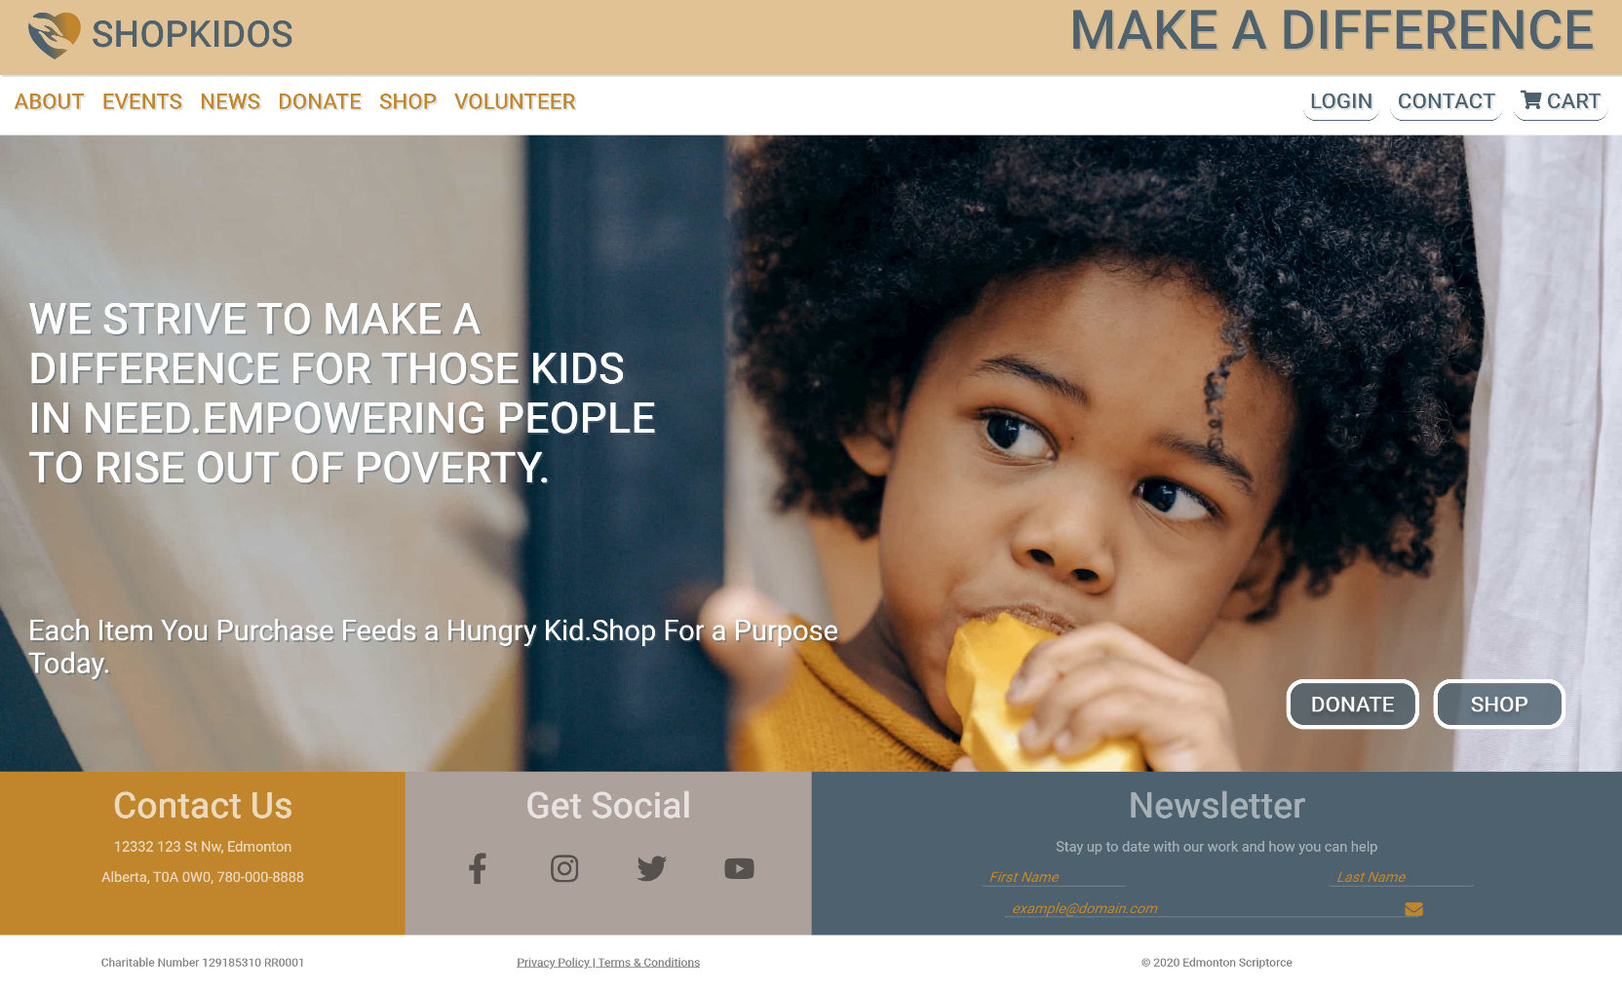
Landing Page
Landing page
Organization logo, and slogan
Website navigation bar
Hero section, with a hint on the website purpose
Donte and Shop buttons to take the user directly to the main activities on the website
Hero footer that features contact us, get social and newsletter subscription section
Regular footer for terms and condition, etc.

Slide 13
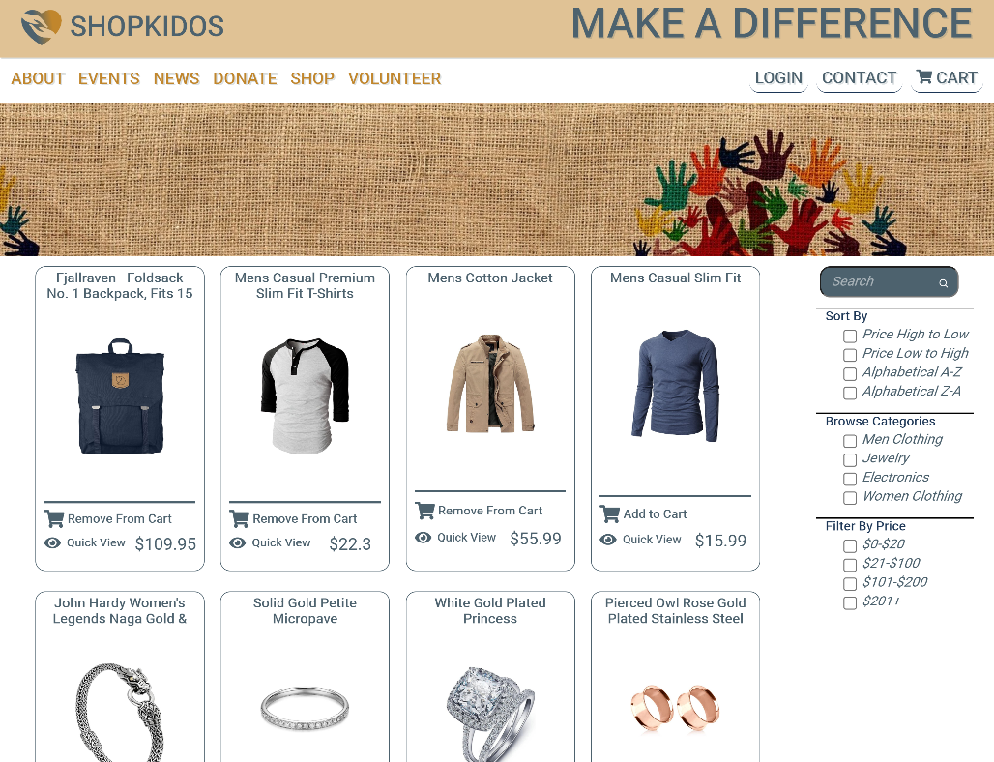
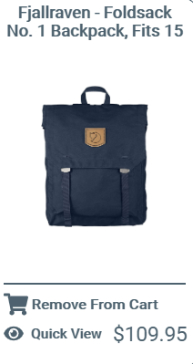
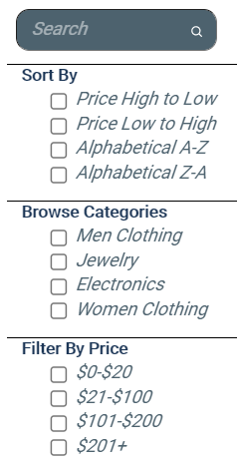
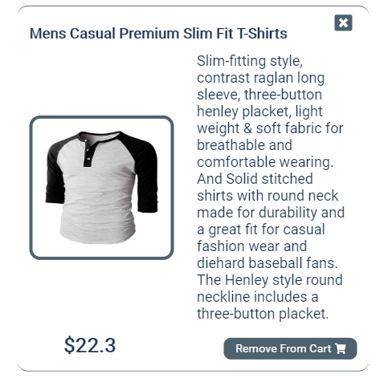
Shopping Page
Product Card
Product side Nav
Product Details Overlay
Shopping Page Features
Shopping page with product cards where the user can see image of the product, price, options to add to cart or open up overlay card displaying more details
Product navigation where the user can search, sort, filter down the displayed products in any order or combination so they can get quicker to what interests them

Slide 14
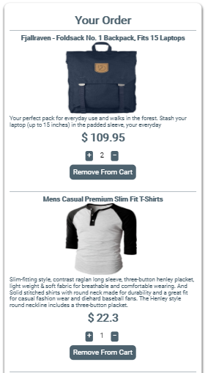
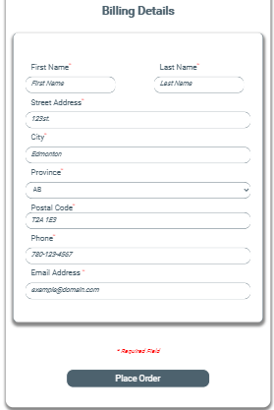
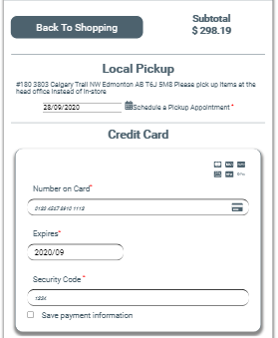
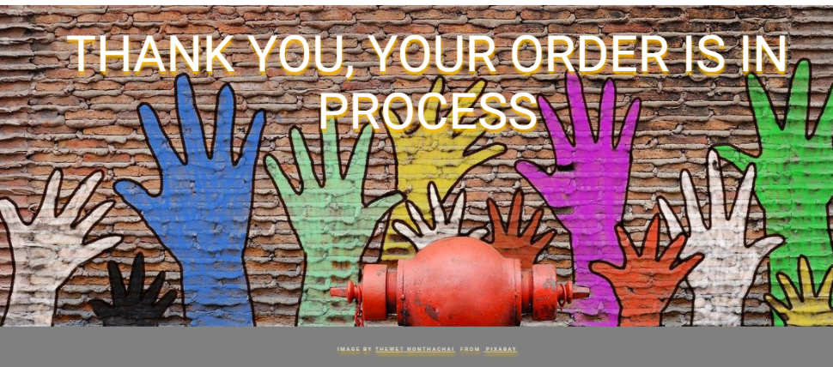
Static Components / Packing lot
Shopping Cart Features
Checkout your items in the cart, to confirm, adjust or remove as desired… Once all details are filled up and the user scheduled pickup date, then all forms will be validated, only then an order confirmation / thank you image would be presented to the user
Notice! the applicate of DRY where the credit card and billing info forms were reused as components in this shopping cart component

Slide 15
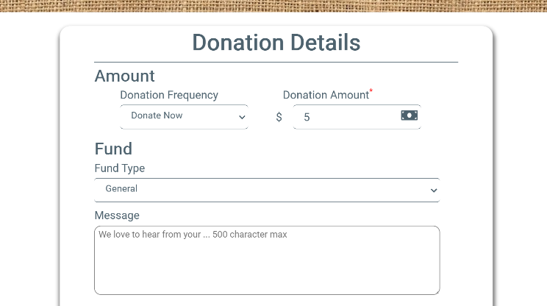
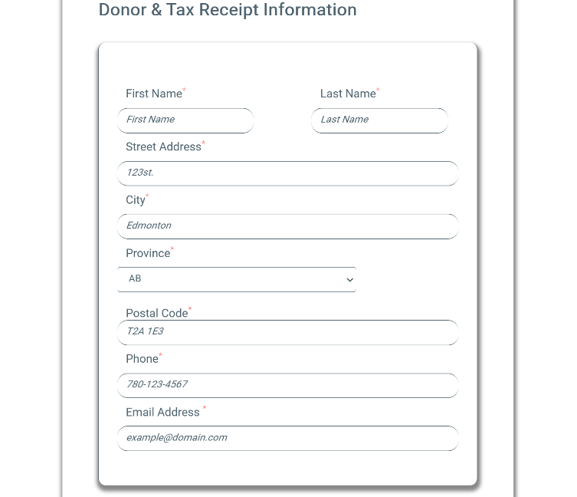
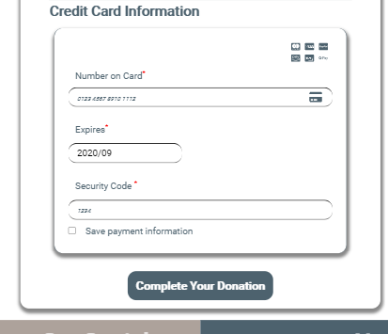
Donation Page
Donation
Here the user can donate to the organization were he will simply select the frequency, amount (min $5), fund allocation and then proceed to fill his billing detail and credit card information
DRY & Code Reusability
The form validation is done using global validation function that was coded generic enough to validate any form without customization demonstrating great DRY practice
Credit card and Billing Info forms are resued within the shopping card component
All three forms are submitted using single submit button using React usRef Hook.

Slide 16
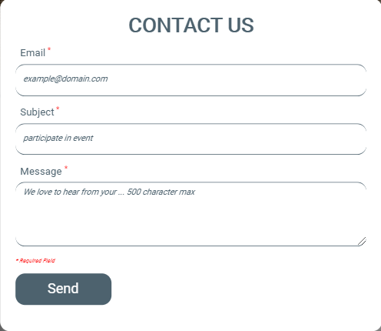
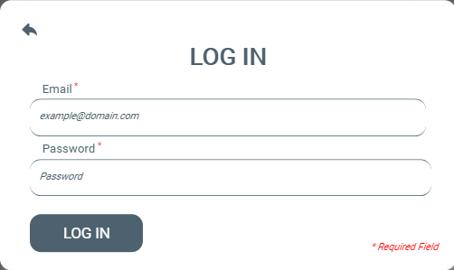
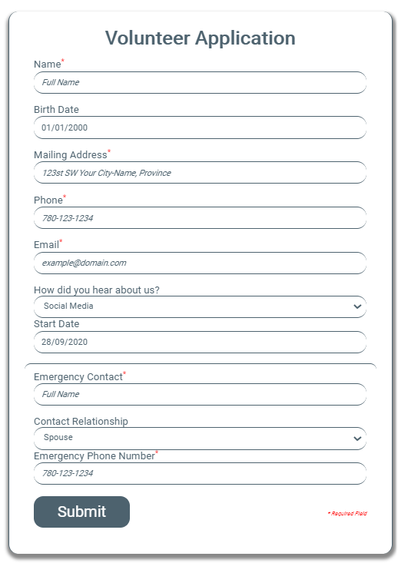
Other Site Forms
Contact form
Log in form
Volunteer Application
All forms are being
Validated per data type and format: email, name, address, credit card no, date, phone, postal code, etc.
No form will be submitted without passing validation
Required fields are superscripted with red asterisk

Slide 17
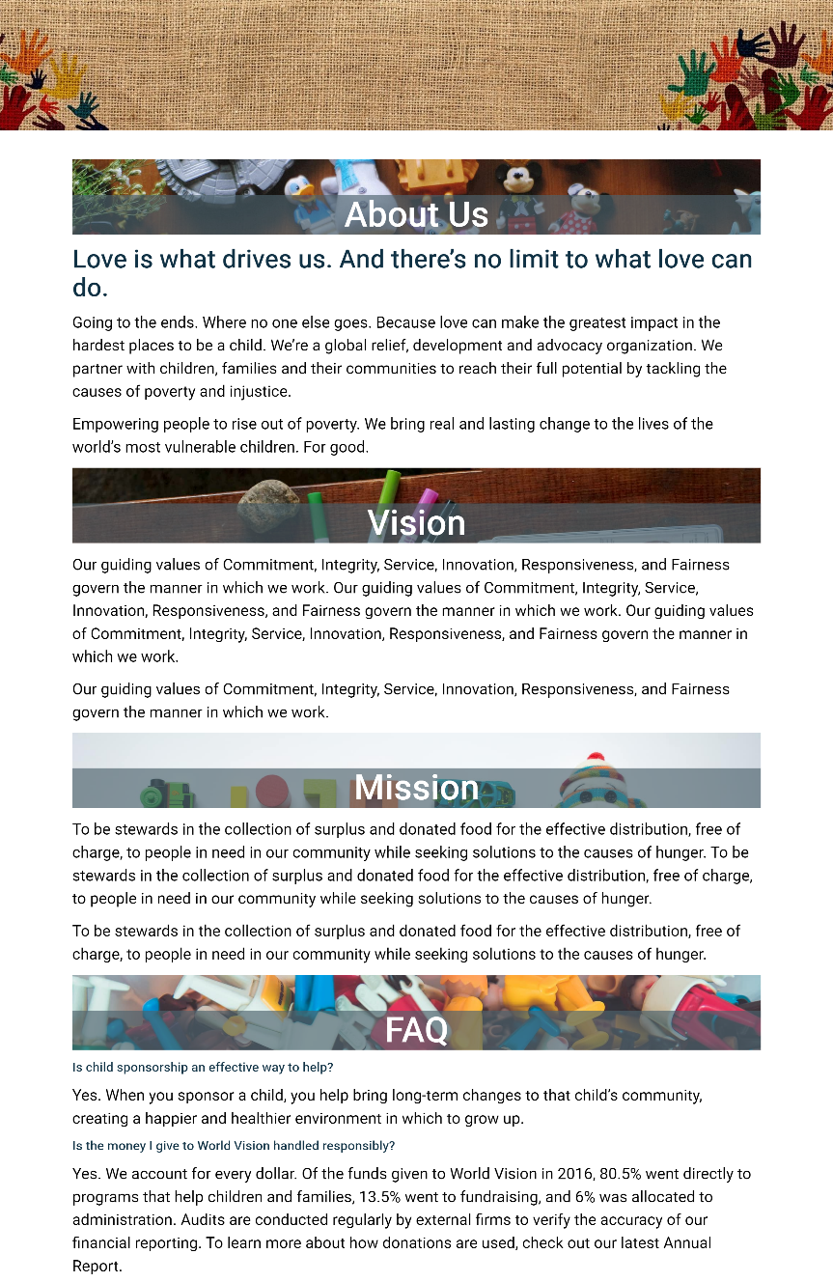
Know us page
Know us page
Where static content go, the page features four main sections:
About us
Vision
Mission
FAQ

Slide 18
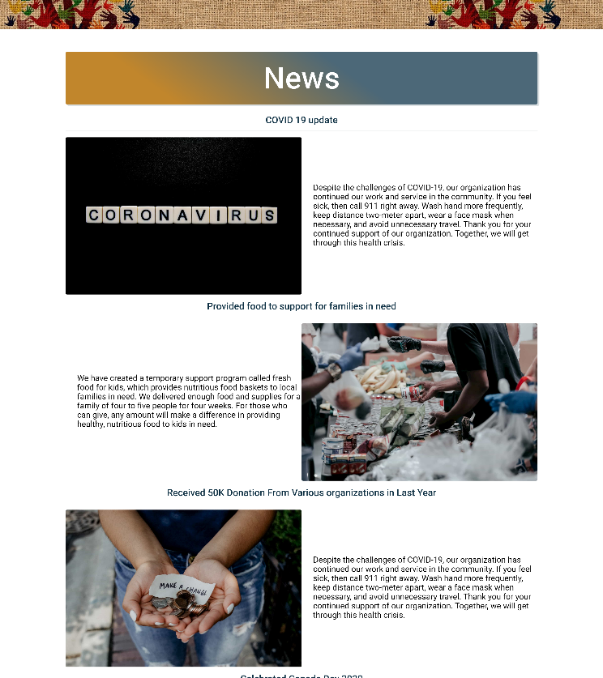
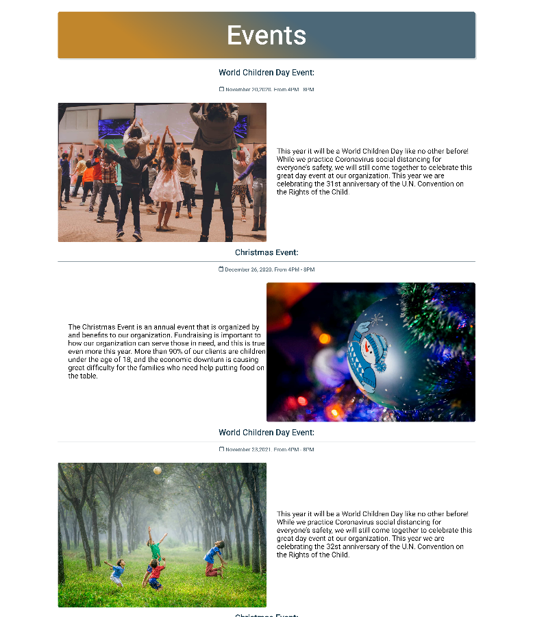
News/ Events page
News / Events page
Where static content go, the page features two major sections:
News, where daily matters are discussed
Events, upcoming and ongoing events to engage local community

